Slide 1
RUNGTA COLLEGE OF DENTAL SCIENCES AND RESEARCH
NEPHROTIC SYNDROME
DEPARTMENT OF GENERAL MEDICINE

Slide 2
SPECIFIC LEARNING OBJECTIVES
MUST KNOW | NICE TO KNOW | DESIRE TO KNOW
NORMAL VALUES FOR PROTEIN EXCRETION | APPROACH TO PATIENTS WITH PROTEINURIA | INTERRELATIONSHIP OF PATHOLOGIC AND CLINICAL MANIFESTATIONS OF GLOMERULAR INJURY
CLASSIFICATION OF CAUSES OF PROTEINURIA | CAUSES OF HYPERLIPIDEMIA | POOR PROGNOSIS FACTORS IN MGN
NEPHROTIC SYNDROME | CAUSES OF HYPERCOAGULABILITY
 | OTHER METABOLIC COMPLICATIONS

Slide 3
CONTENTS
NORMAL VALUES FOR PROTEIN EXCRETION
APPROACH TO A PATIENTS WITH PROTEINURIA
CLASSIFICATION OF CAUSES OF PROTEINURIA
NEPHROTIC SYNDROME
CAUSES OF HYPERLIPIDEMIA
CAUSES OF HYPERCOAGULABILITY
OTHER METABOLIC COMPLICATION
INTERRELATIONSHIP OF PATHOLOGIC AND CLINICAL MANIFESTATIONS OF GLOMERULAR INJURY
POOR PROGNOSIS FACTORS IN MGN
SUMMARY

Slide 5
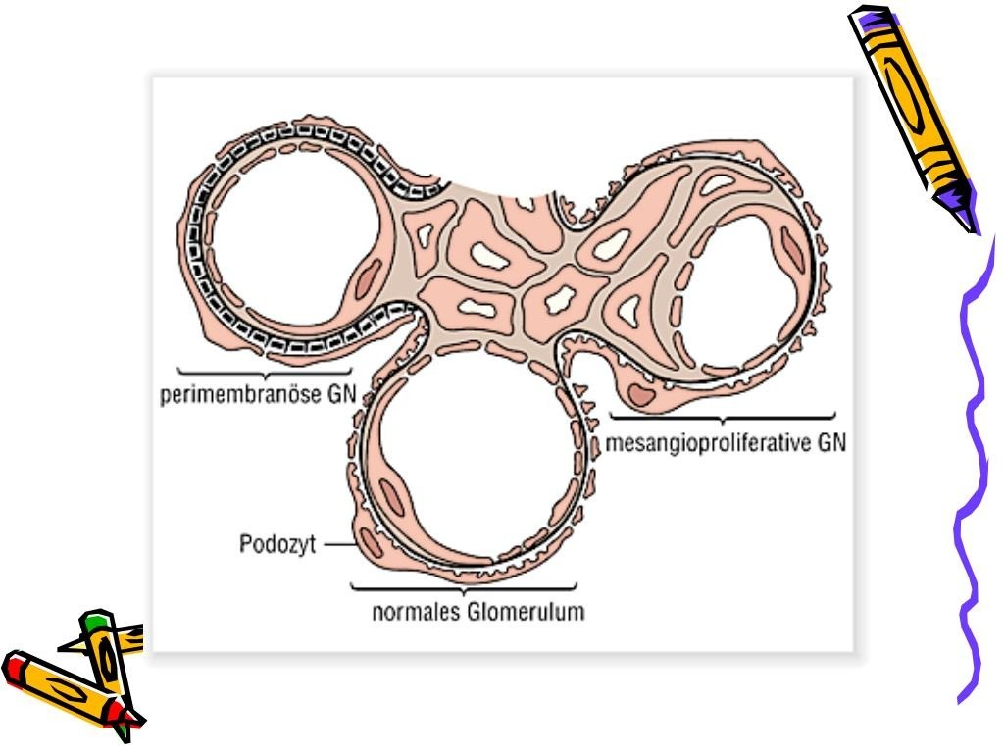

Slide 6
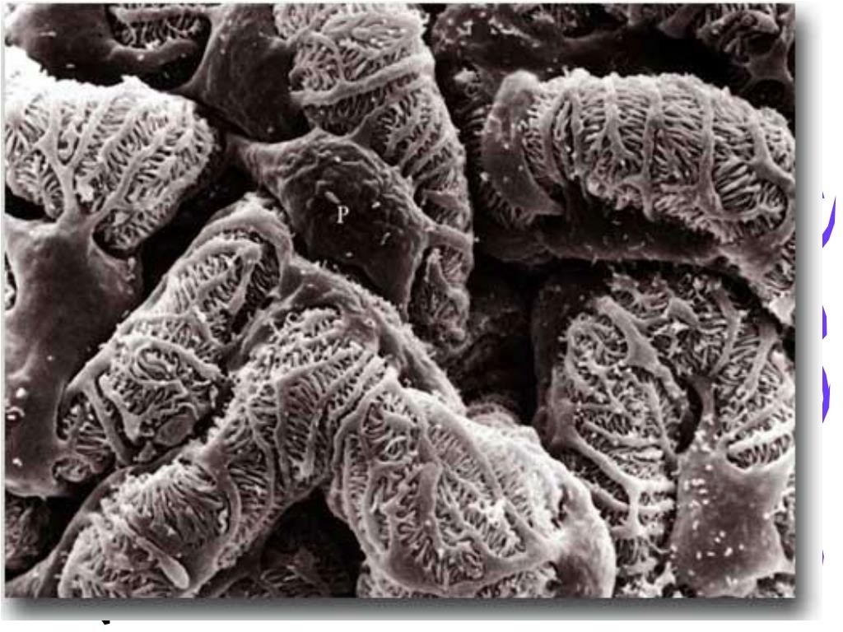

Slide 19
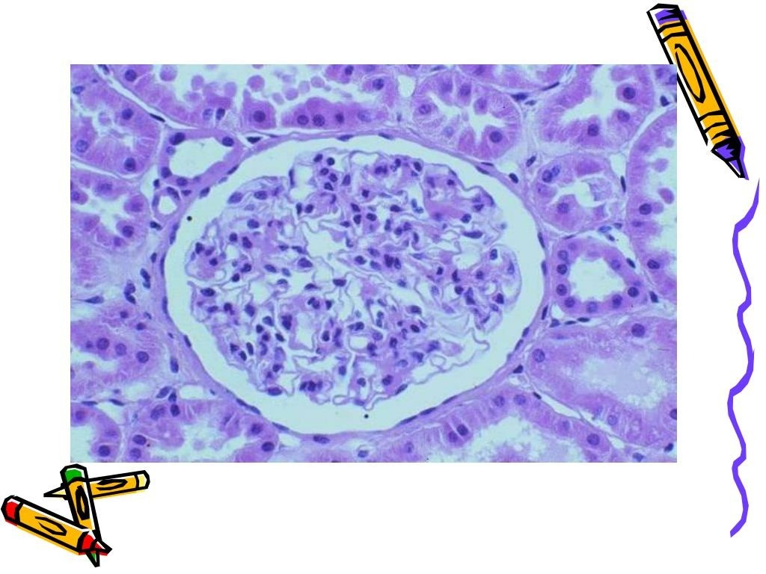

Slide 20
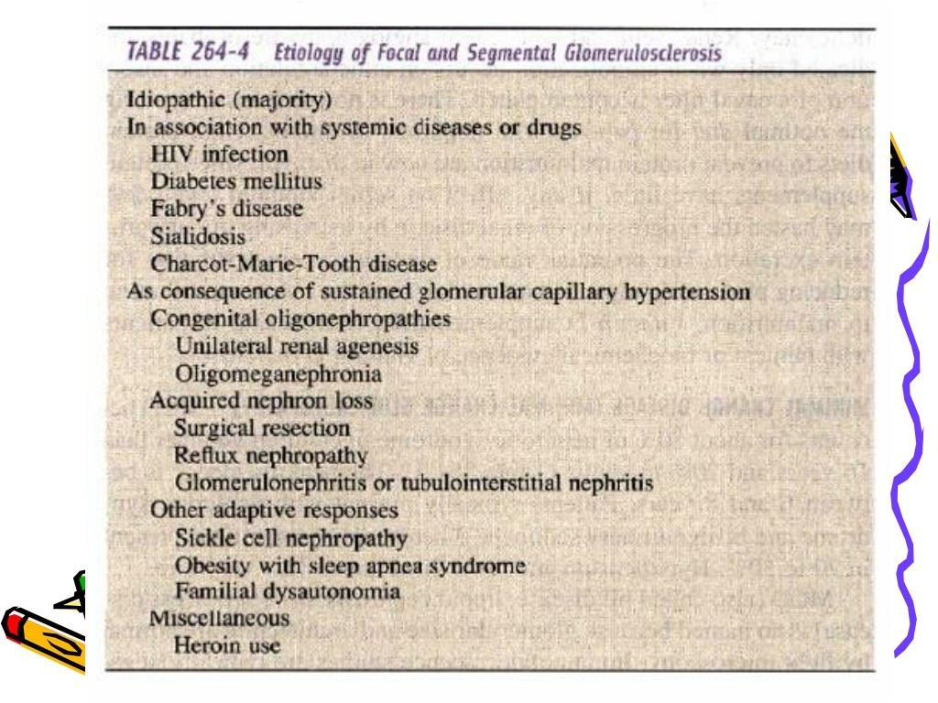

Slide 21
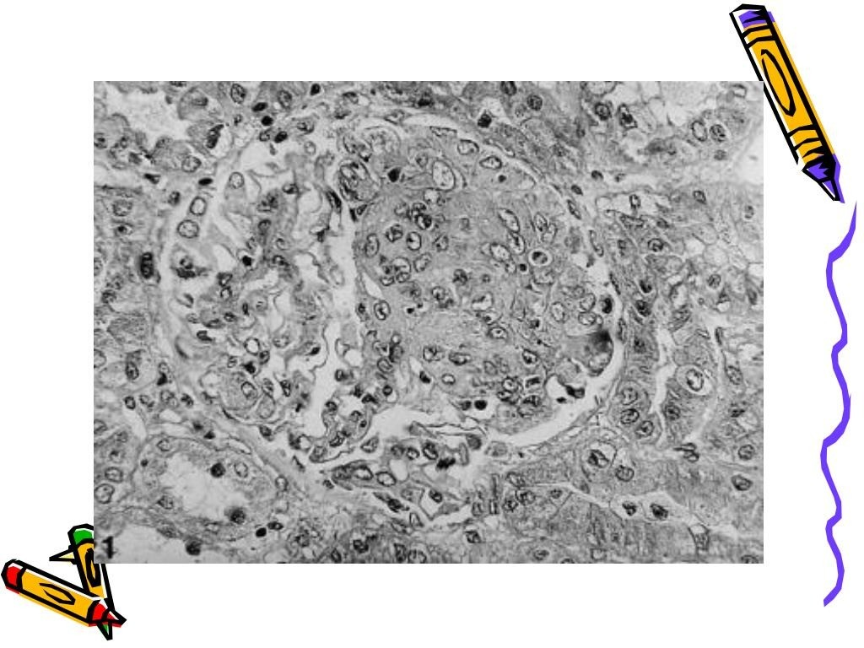

Slide 22
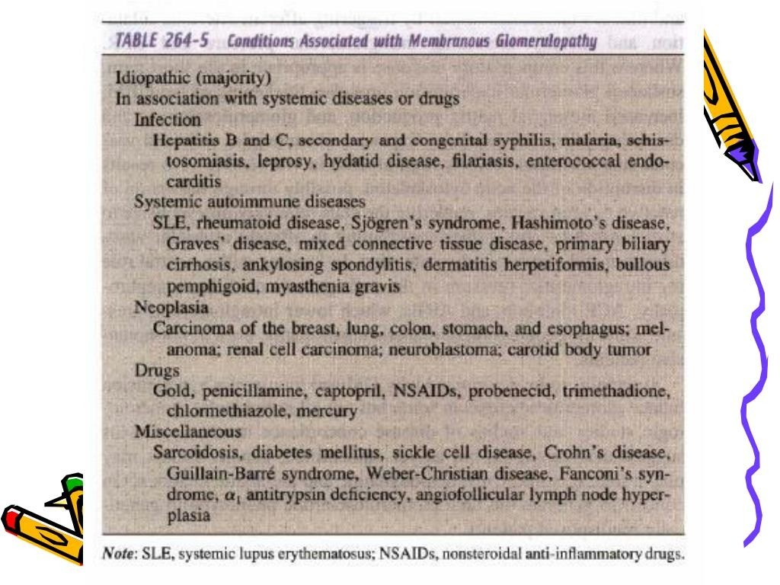

Slide 23
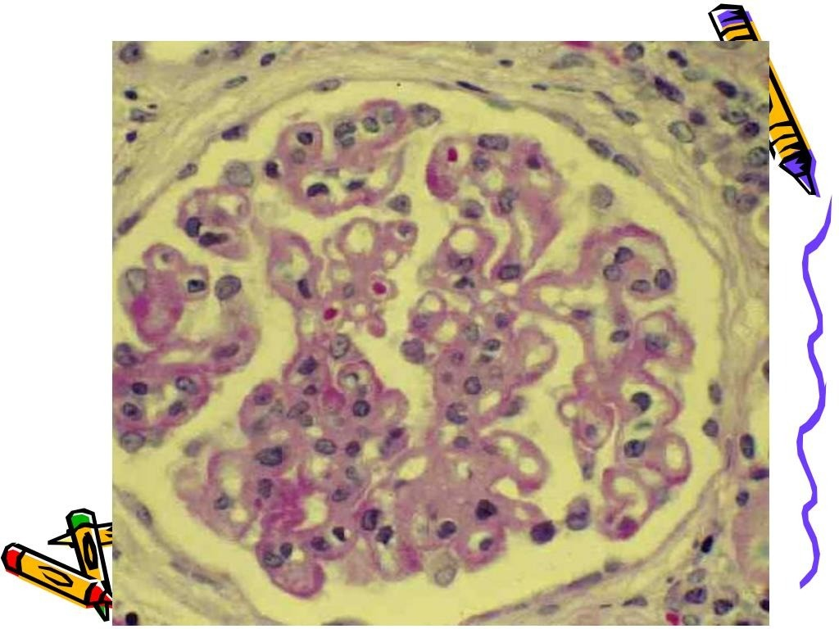

Slide 25
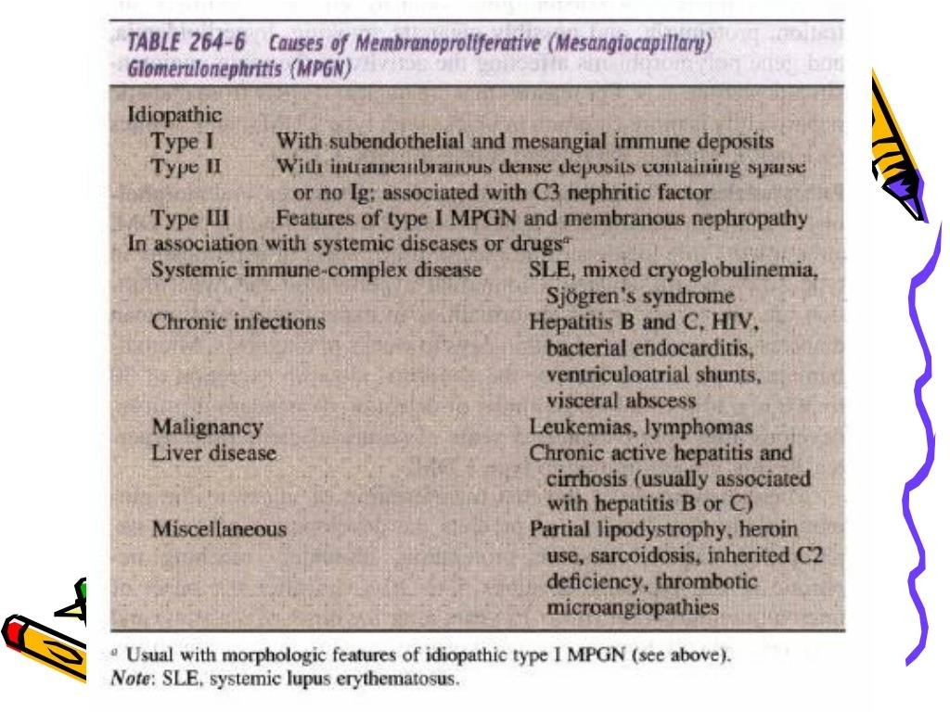

Slide 26
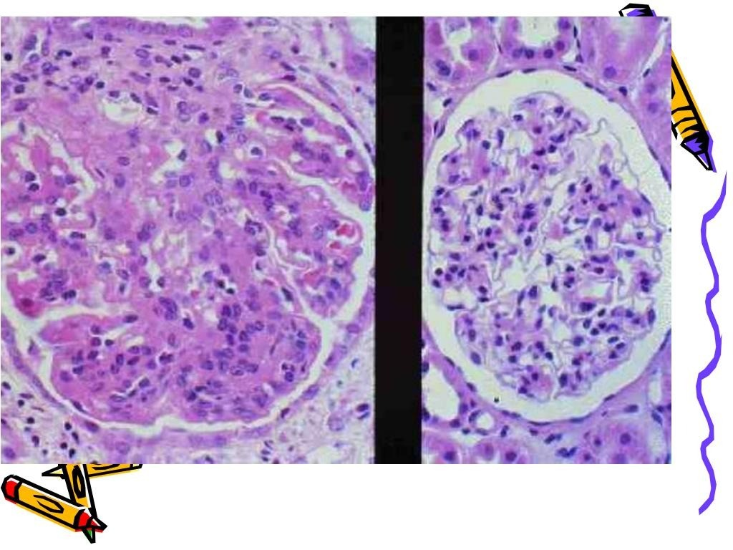

Slide 27
SUMMARY

Slide 28
REFERENCES
DAVIDSON’S PRINCIPLES AND PRACTICE OF MEDICINE; 23rd edition
HARRISON’S PRINCIPLE OF INTERNAL MEDICINE; 21ST edition
TEXTBOOK OF CLINICAL MEDICINE by S.N Chugh ;5th edition

Slide 29
QUESTIONS AND ANSWERS

Slide 30
THANK YOU

